Slide 1


RBQM Workshop
OpenRBQM Working group
Building Open-Source Tools paired with Central Monitoring Best Practice
Jeremy Wildfire, Gilead
Jenn Krohn, Gilead
Spencer Childress, Gilead
Jon Harmon, Atorus
Devin Pastoor, A2AI
Anne Zheng, A2AI
phuse.global/working_groups

Slide 2
Getting Started
Set up Project on Posit Connect
Open Repo: https://github.com/OpenRBQM/PhuseConnect25
Open Link to Posit Cloud Project
Log in/Create an Account
Click on the 'assignment' to make yourself a copy
Follow along with hands on exercises

Slide 3
Agenda
10 min - RBQM Overview - Jenn Krohn
10 min - OpenRBQM - Jeremy Wildfire
20 min - Hands on - Analytics - Spencer Childress
20 min - Hands on - Deep Dive - Jon Harmon
20 min - Architecture and Automation - Devin Pastoor
10 min - Wrap-up - Jeremy Wildfire

Slide 4
Workshop Objectives
Understand what RBQM is and how it’s done
Learn about open-source collaboration and contribution
Learn how to evaluate KRIs on your own studies
Learn how to use a Shiny app to investigate risk signals
Learn how to set up the infrastructure at your organization to run RBQM analytics

Slide 5
Part 1 - Intro To RBQM & CM
Jenn Krohn

Slide 6
RBQM
Increased study quality
What is RBQM?
Focuses Resources on Most Impactful Activities
Early ID of Issues
Prevents Gaps &
Recurrence
An adaptive, cross-functional, study monitoring process that begins with protocol design, identifies areas most critical to the study, & directs monitoring focus to risks & factors critical to safety & quality.
Benefits of RBQM
Leverages technology for ongoing remote data surveillance & comprehensive risk management throughout the trial lifecycle.
Standardized Tools & Systems
Improved
Operational
Efficiency
Employs various tools, platforms and dashboards to identify signals, which indicate potential issues.
Alignment to Current & Future
Regulatory
Expectations
Allows study teams to concentrate on high value tasks and focuses resources on activities with the most potential to impact patient safety and data quality.

Slide 7

Quality
Quality is the absence of meaningful errors.

Slide 8
CtQ: Data & Process
Critical Data
Critical Process
Data deemed important to the reliability of the study findings, specifically those that support primary and key secondary endpoints, as well as data related to safety and key eligibility criteria.
(exploratory/tertiary Endpoints are not considered critical)
Any process that is essential to the reliability of study findings and/or related to ensuring participant safety and rights
Examples:
Informed consent process
Randomization process
Protocol specific intervention or procedures
Dosing

Slide 9

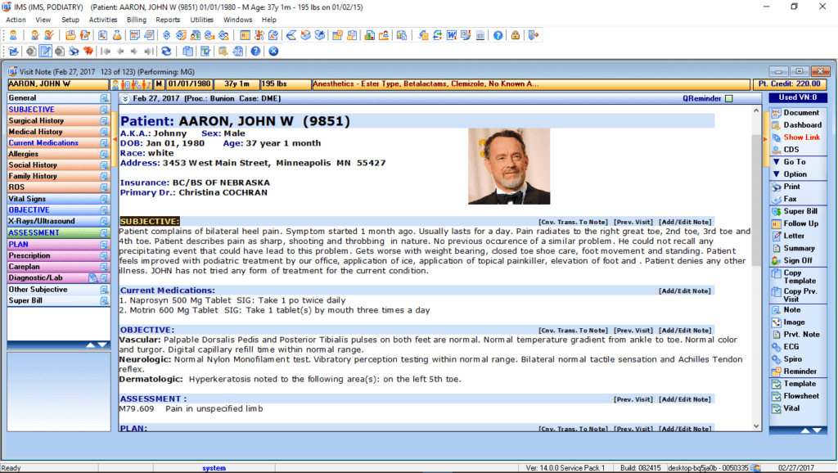
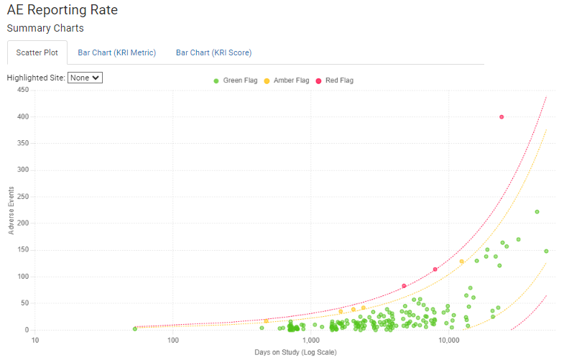
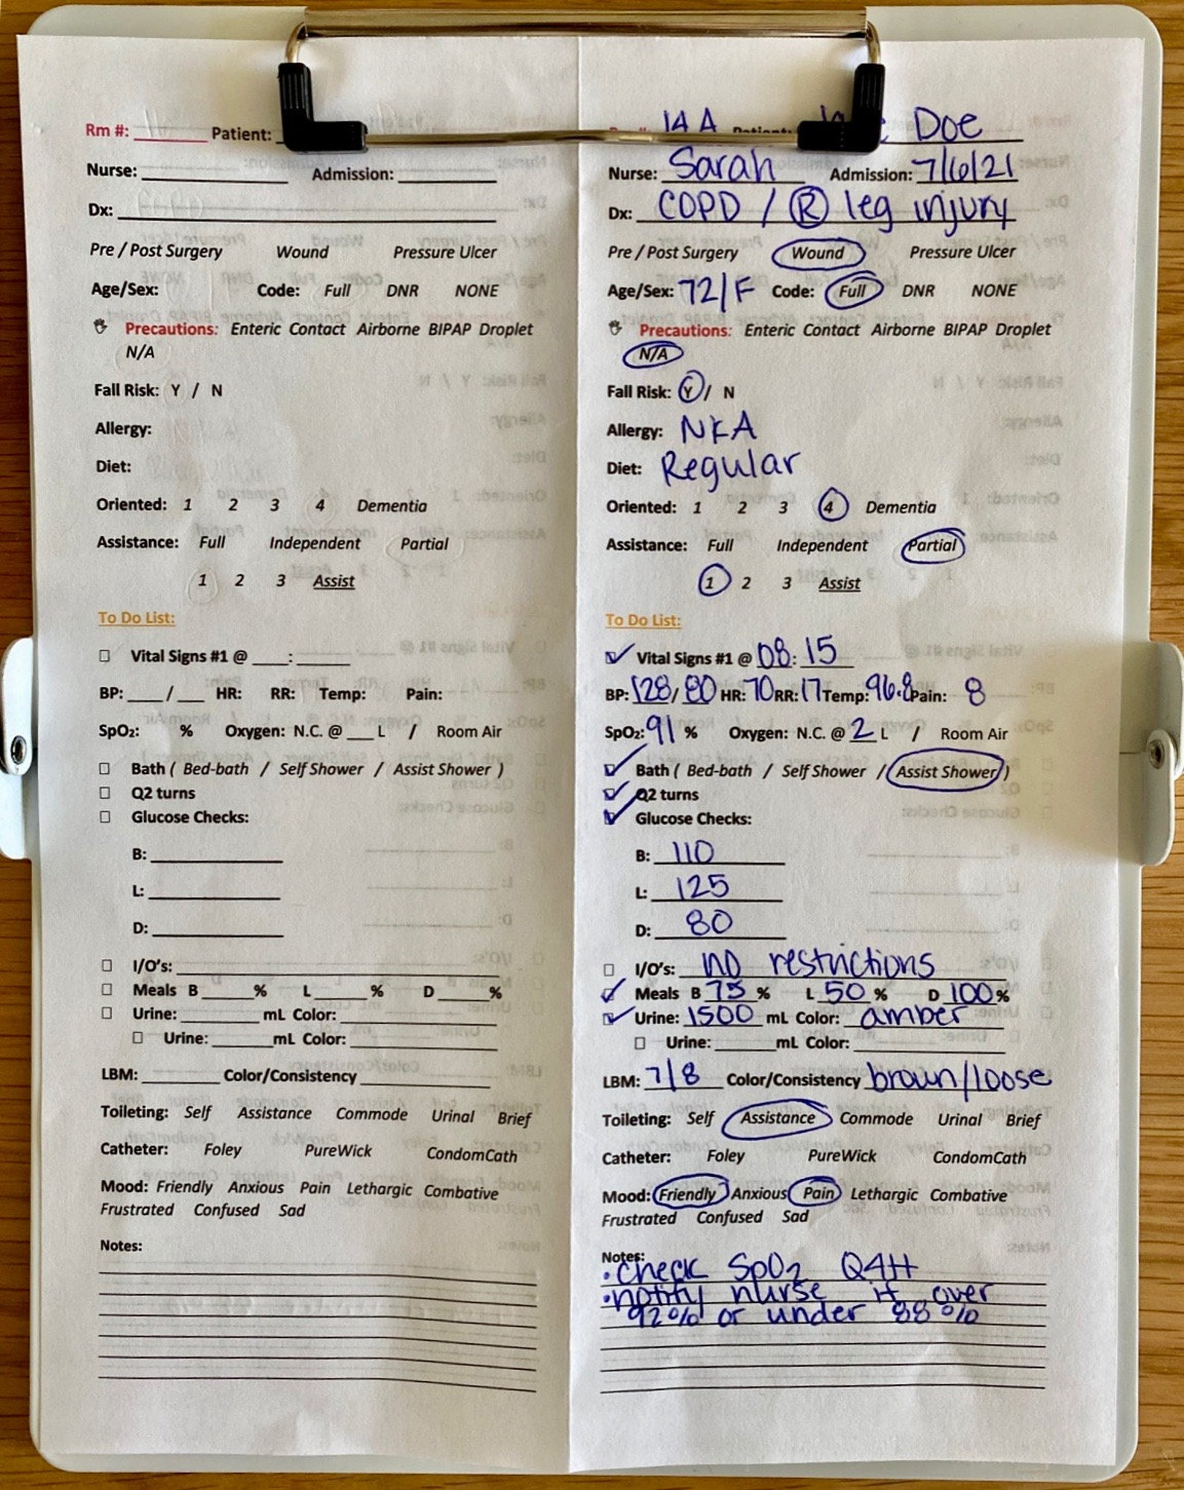
Centralized Monitoring (CM)
Centralized monitoring is a holistic view of the data used to identify trends, patterns, unusual variation in the data (aligned with ICH)
This is a vantage point that operations teams do not have
Helps operations teams target specific process risks at the study, region, country, or site level
Should focus primarily on the CtQ factors identified for the study
What CRAs see is extremely limited.
CM Enables a Unique, Holistic View.

Slide 10
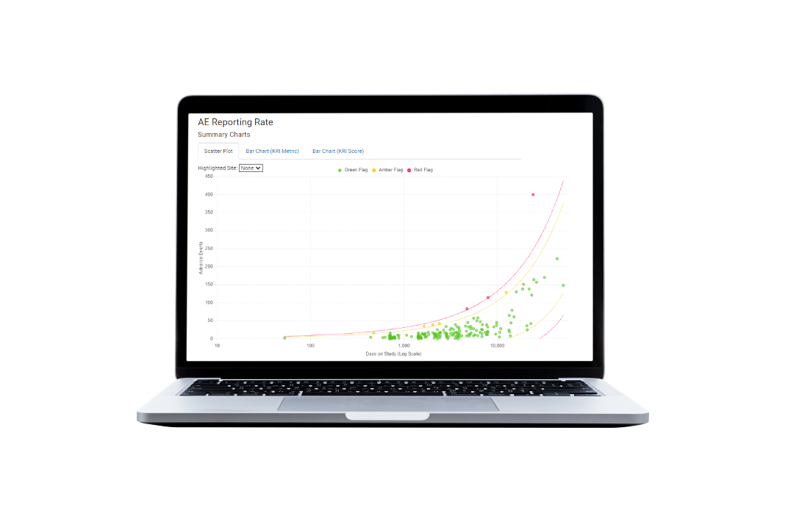


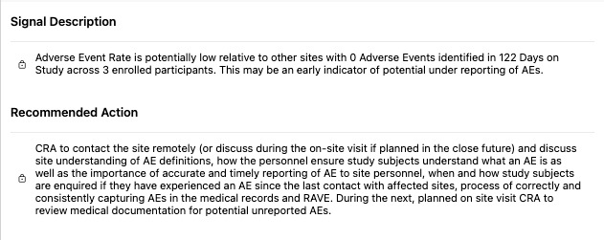

Taking Action on CM Signals
Central Monitor evaluates data signal & translates into something operational teams can easily understand and action.
Signal is tracked in CTMS (or other system) where it becomes a part of the CRA’s regular site monitoring process.
The CRA then evaluates the site’s process with the study coordinator and/or PI via RCA to evaluate potential gaps. Mitigation is then implemented.

Slide 11
Part 2 – OpenRBQM
Jeremy Wildfire

Slide 12
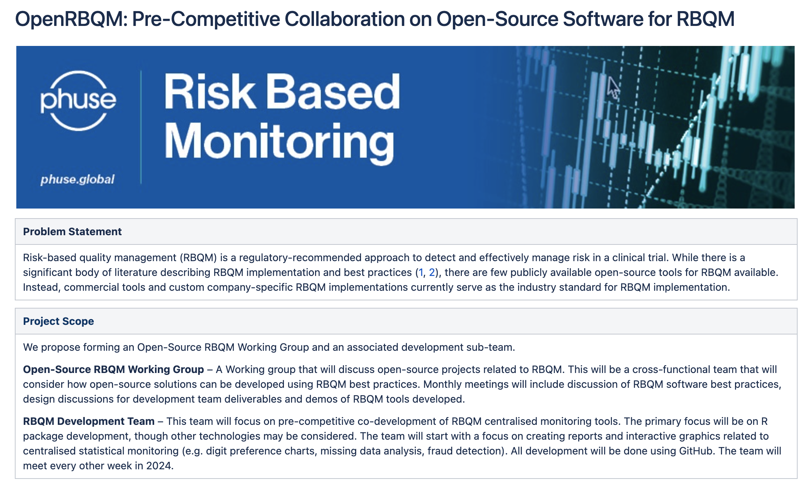

Slide 13
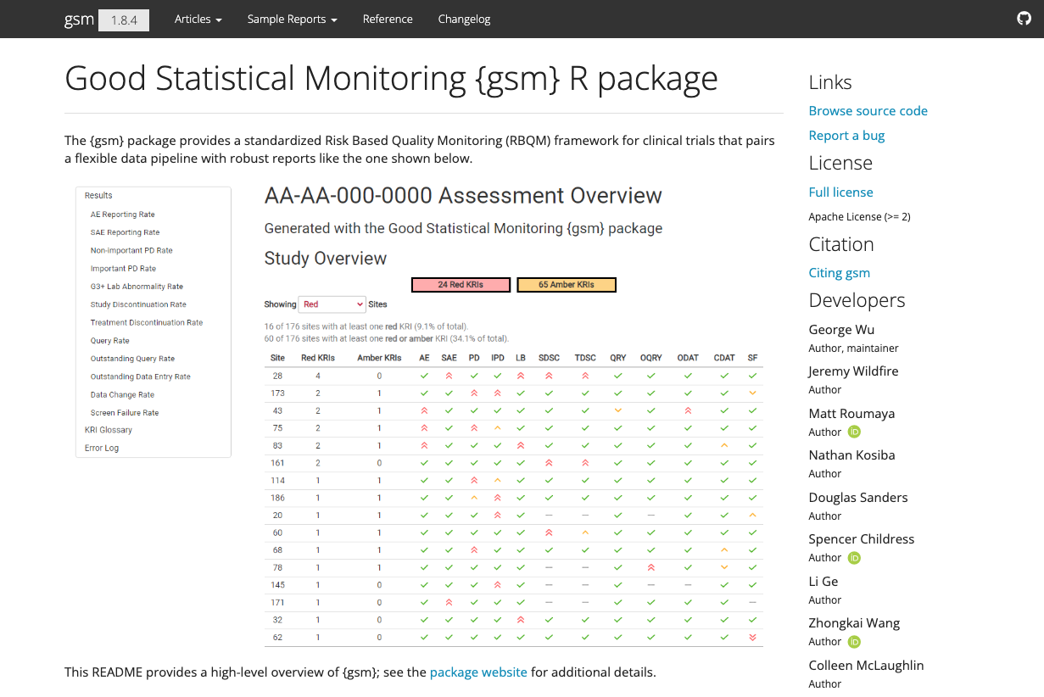
The Good Statistical Monitoring or “gsm” package is a free and open-source framework for RBQM analytics. The package provides a standardized Risk Based Quality Monitoring (RBQM) framework for clinical trials that pairs a flexible data pipeline with interactive reporting.
Learn more at https://gilead-biostats.github.io/gsm.core/

Slide 14


Slide 15


Slide 16
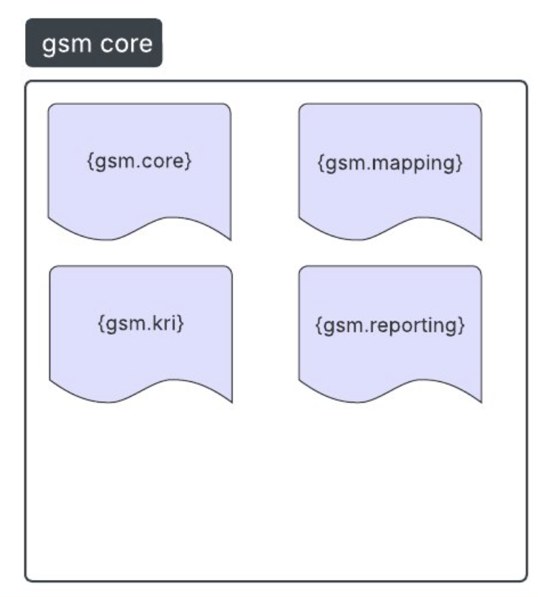
{gsm} is now {gsm.core}

Slide 17
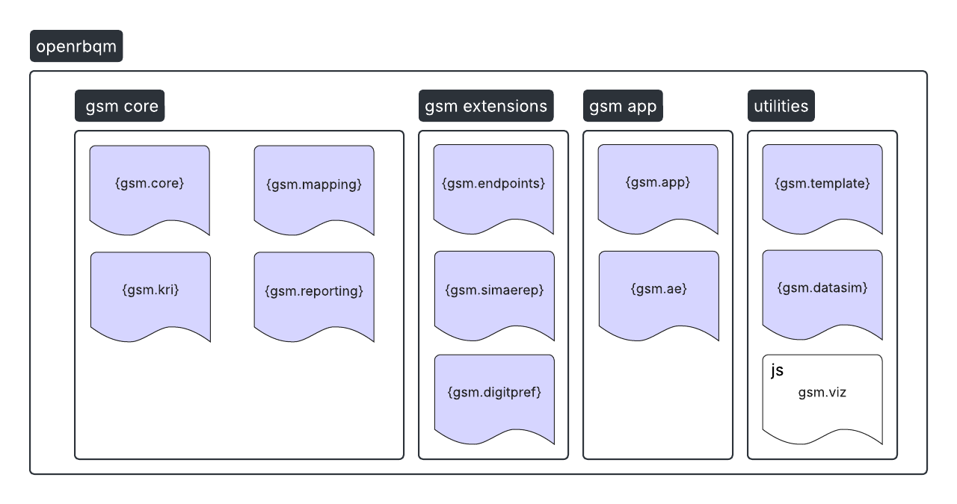
A. i

Slide 18
Package Developers
Study Analysts (DM, SP, Bios)
RBQM / CM team
Study Team
IT / Quality
CRO Partners
Technical Implementation
RBQM Process

Slide 19
Individual Analyst
Enterprise Framework
OpenRBQM
Technical Use Cases

Slide 20
Part 3 – {gsm} Analytics
Spencer Childress

Slide 21
Overview
How to create and run single metric
Analysis pipeline overview
Hands-on
Open Posit Workbench
Review the setup/file structure
Run analysis pipeline
Review KRI report

Slide 22
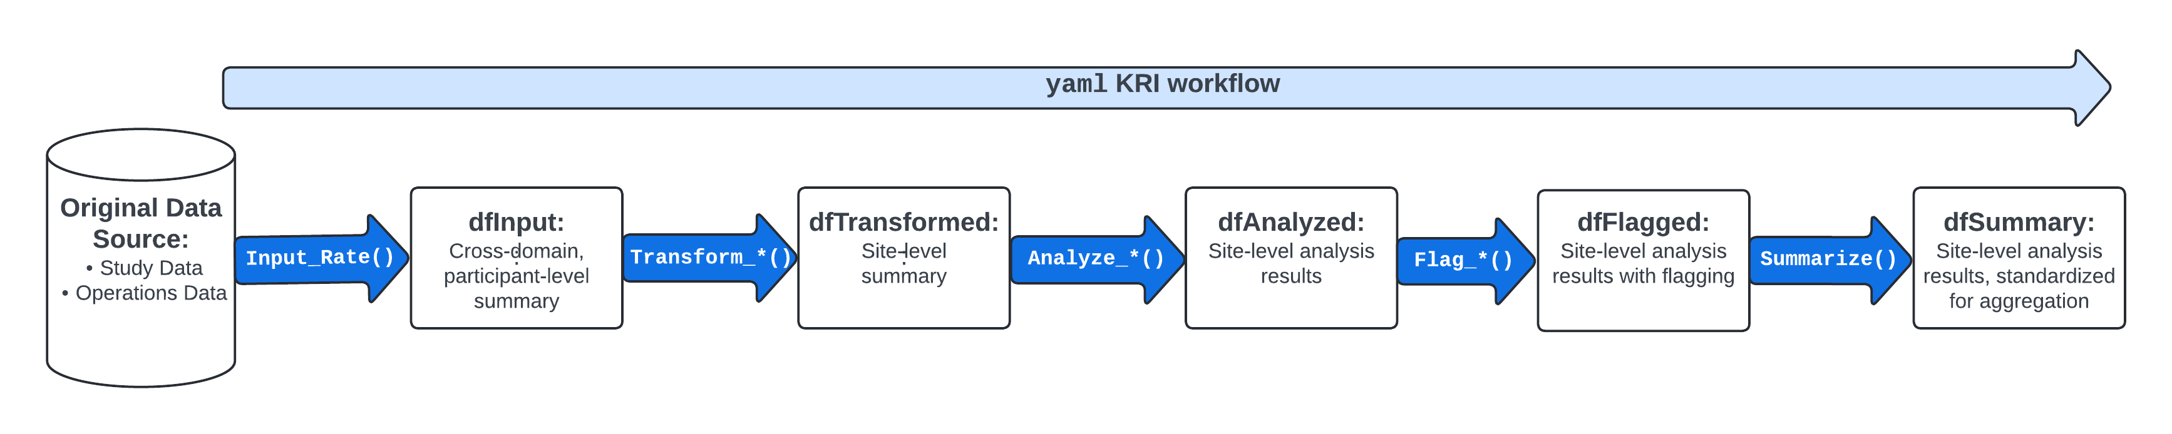
Analysis Pipeline

Slide 23
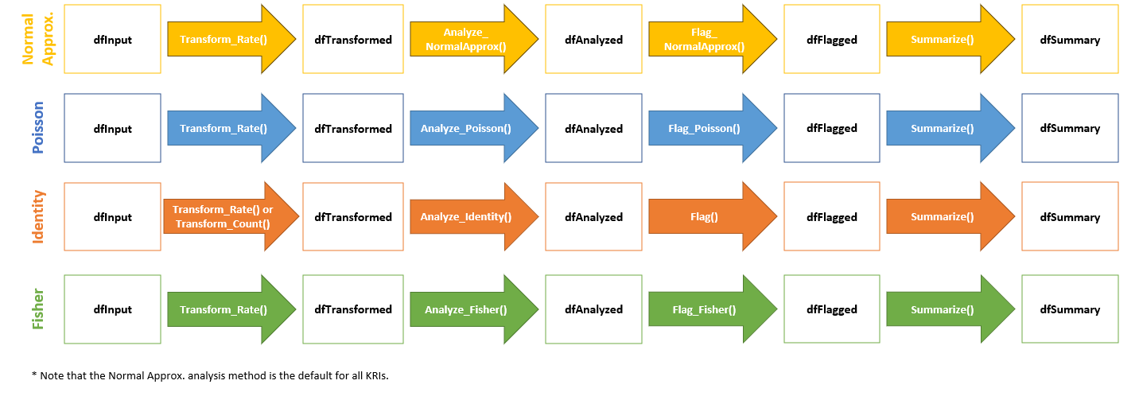
Statistical Models Available For Each Assessment

Slide 24
Create and Run Single Metric
Open and explore `sae-kri.R` file:
source() data from 'R/DataIO.R’ to load data input/output helpers
Use gsm.core::Input_Rate() function to calculate SAE reporting rate
Use gsm.core::Transform_Rate() to transform the input for analysis
Use gsm.core::Analyze_NormalApprox() to analyze the transformed data using normal approximation
Use gsm.core::Flag() to flag sites based on thresholds with threshold values of c(-3, -2, 2, 3)
Note: AE KRI transformed into SAE KRI by applying filter to aeser variable
Resources: Step-by-Step Analysis Workflow

Slide 25
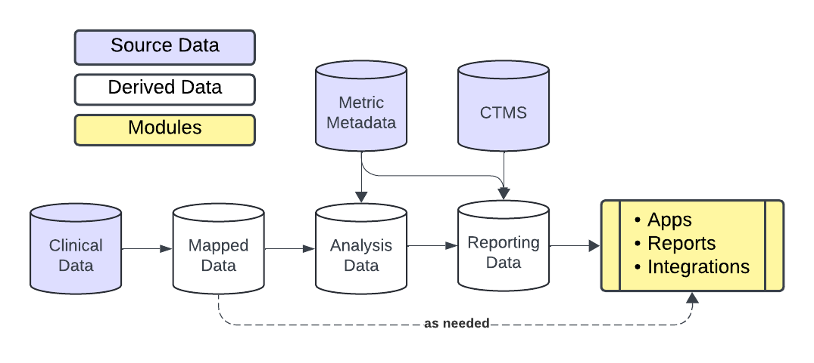
Analysis Pipeline

Slide 26
Analysis Pipeline
Study/Site Metadata
SDTM

Slide 27
Analysis Pipeline
Data prep

Slide 28
Analysis Pipeline
Evaluate KRIs

Slide 29
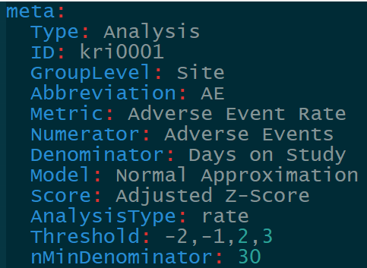
Analysis Pipeline

Slide 30
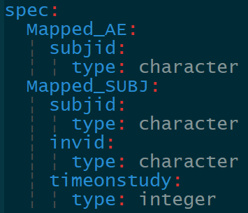
Analysis Pipeline

Slide 31
Analysis Pipeline

Slide 32
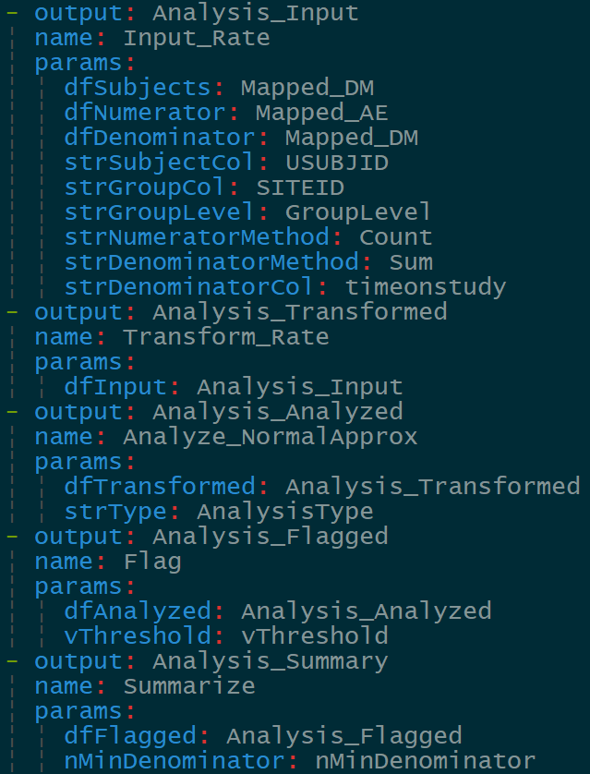
Analysis Pipeline

Slide 33
Analysis Pipeline
Compile data

Slide 34
Analysis Pipeline
Generate report

Slide 35
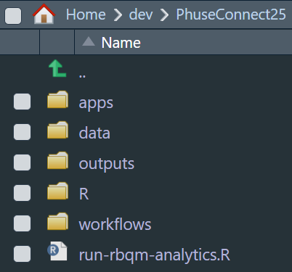
Hands-on
Open Posit Workbench with requisite packages in the OpenRBQM ecosystem installed
Review the setup/file structure

Slide 36
Hands-on
Run analysis pipeline
View Files (CMD/CTRL+SHIFT+5)
Click run-rbqm-analytics.R
Run each step interactively
Open report in ./outputs

Slide 37
Hands-on
Create a new KRI: SAE Reporting Rate (time permitting)
Under./workflows/2_metrics copy adverseEventReportingRate.yaml and rename seriousAdverseEventReportingRate.yaml
Open the new workflow and update the information in meta
Add aeser to data spec for Mapped_AE
Add a new step that filters Mapped_AE on serious AEs
Pass the output of the step above to the dfNumerator of Input_Rate
Rerun analysis pipeline

Slide 38
BREAK

Slide 39
Part 4 – Deep Dive with {gsm.app}
Jon Harmon

Slide 40
Overview
{gsm.app} overview
Hands-on
Demo app.
Customizing for your data.
Plugins.

Slide 41
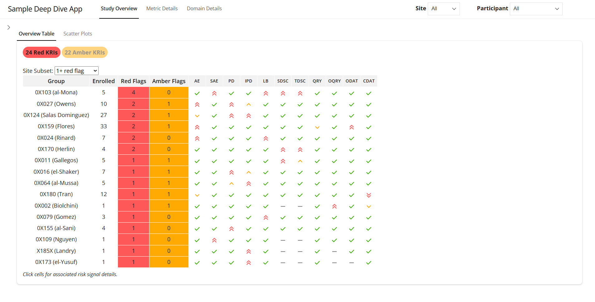
{gsm.app}
Deep-dive shiny app for investigating risk signals.
Designed to work with other gsm components.
Works with your data.
Plugin framework.

Slide 42
Hands-on: Demo app
apps/1_demo/app.R
"Run App" (or ctrl-shift-R).
This version uses sample data.
Explore.

Slide 43
Hands-on: Fetch Function
apps/2_workshop_data/app.R
"Run App" (or ctrl-shift-R).
fetchData function passed into run_gsm_app
Customize to change how domain data is fetched
Explore.

Slide 44
Hands-on: Plugins
apps/3_plugins/app.R
"Run App" (or ctrl-shift-R)
lPlugins = list(pluginAE())
Allows for customization of deep dive tabs
Note tweak to fetchData function!
Explore.

Slide 45
Part 5 – Cloud-based Automation
Devin Pastoor

Slide 46
Cloud-based Automation
RBQM is a continuous process
Requires ongoing evaluation of KRIs
Prime candidate for automation
Setup of cloud-based environment with scheduled actions

Slide 47


